Slide 1
Chapter 3 Labor force participation

Slide 2
Definition and Measurement of Labor Force
Non-institutional Population: ?
Labor force participation rate: ?
Labor force: ?
Unemployment rate: ?
Employment rate: ?
Discouraged worker: ?

Slide 3
Definition and Measurement of Labor Force
Non-institutional Population:
People who were less than 16 years of age or were confined to prisons, mental hospitals, or other institutions were immediately excluded from consideration as potential labor force participants, since they are presumed to be unable to work. Subtracting this group from the total population yields the non-institutional population.

Slide 4
Definition and Measurement of Labor Force
Labor force participation rate:
It measures the people in the labor force as a percentage of non-institutional population.
LFPR = (LF/ NIP) x 100
Labor force:
L.F.= Employed + Unemployed
Employed:
It includes anyone working for pay at least one hour a week who is not an institution or the armed forces.

Slide 5
Definition and Measurement of Labor Force
Unemployed:
It is defined as- i) he or she out of work, ii) looking for work, and iii) able to take a job if it is offered. The “looking for work” here represents as to find work in the previous four weeks.
Unemployment Rate:
%U = [Total unemployed / Labor Force] x 100
Employment Rate:
% E = [Total employed / Labor Force] x 100

Slide 6
Definition and Measurement of Labor Force
Discouraged worker:
If a person is not in the labor force, wants a job, is available for work, and has looked for work sometime in the past 12 months (but not recently), he or she is called discouraged worker, implying that he or she given up even looking for work because of poor job prospects.

Slide 7
Decision to Work
An employee is willing to join in the labor force if the market wage exceeds his or her reservation wage.
When the budget constraint and the indifference curve are just tangent, an outcome economists call an interior solution. Graphically, if the ICs are relatively steep, or the BC is relatively flat, however, no interior solution may be possible. In this case, a corner solution will be observed.
The slope of the indifference curve at point zero hour of work is of particular significance and is called the reservation wage; it measures the amount of money the person would have to be given to be induce to work the first hour.

Slide 8
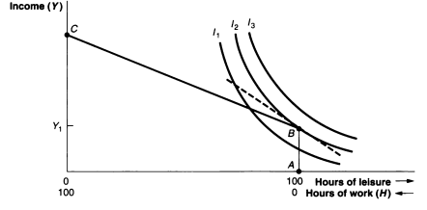
A corner solution and non-participation in the labor force
For a person to participate in the labor force, therefore, the fundamental requirement is that the market wage exceed the reservation wage.

Slide 9
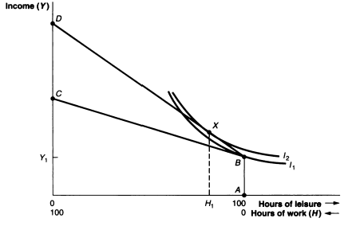
The Effect on Participation of a Change in the Wage Rate
It is observed that a rise in the wage rate may cause a person already working in the market to either work more hours or fewer hours, depending on the relative size of the income and substitution effect.
If the person is not in the
labor force, however, a
rise in the wage rate will
unambiguously increase
the probability of entering
the labor force to seek
market work.

Slide 10
The effect of participation of A Change in the wage rate
The reason is that a rise in the wage cannot give rise to a negative income effect as long as hours of work and (and earnings from work) are zero.
A rise in market wage will continue to give rise to a positive substitution effect, however, since every hour of non-market time now more expensive.
Here, at point X,
MW > RW
Whereas at point B,
RW> MW

Slide 11
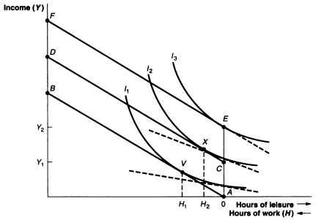
Participation and Changes in Non-labor Income
The probability of labor force participation decreases with the amount of non-labor income increases while other things remaining the same.

Slide 12
A Household model of labor supply
Limitation of Labor/Leisure model: Labor/Leisure model is deficient in the two following respects:
First: it ignores the family context in which the labor supply decisions of husbands and wives are made. However, the allocation of time to work requires the combined decisions of both husband and wife to pool their resources to maximize the utility of entire family.
Second: it does not realistically represent the set of choices open to men and women with respect to their use of time. Rather than strict dichotomy between labor and leisure, married women had traditionally had three alternatives: market work, nonmarket work or homework and leisure.

Slide 13
A Household model of labor supply
Jacob Mincer and Marvin Kosters were the first to broaden the labor/leisure model to take into account both of these objections to introduce the Household Model of Labor Supply.
The decision making unit in this household model is the family, composed of a husband, wife, and possibly one or more children.
The family members have three uses of time: market work, nonmarket work or homework and leisure.
The attainable combination of these three activities are constrained by----
The wage rate that each family member can earn.
The family’s level of non-labor income.
The total discretionary time of the family per week.

Slide 14
A Household model of labor supply
Effect of changes in non-labor income on the family’s allocation of time:
An increase in the amount of non-labor income available to the family will, therefore, set off a negative income effect, leading to a reduction in hours of work on the part of all or some of the family members.
Effect of changes in wage rate on the family’s allocation of time of each family member:
A change in the wage rate of person i in the family will affect both the individual’s own labor supply decision and the labor supply decision of another family member , person j through different and distinct channels.

Slide 15
A Household model of labor supply
First: a change in the wage of person i (Wi) will lead to a positive substitution effect on the hours of work of person i (Hi).
Second: the change in wage (Wi) will also affect Hi through a countervailing negative income effect.
Third: Cross-substitution effect: This measures the effect of a change in the wage rate of person i on hours of work of person j in the family.

Slide 16
A Household model of labor supply
Third: Cross-substitution effect:
Holding income constant, a rise in the wife’s wage leads her to work more through the substitution effect.
If wife’s and husband’s time in the market are substitutes, as she works more he will work less (e.g. spend more time cooking and cleaning at home), leading to a negative cross-substitution effect.
In contrast, if wife works more in the market so does husband, e.g. leisure time is only enjoyed if they share it together and, thus as she reduces her amount of time devoted to leisure so does her husband. In this shape of complements, the cross-substitution effect is positive.

Slide 17
A Household model of labor supply
The household model of labor supply also provides several key insights into different facets of labor force participation:
The division of labor by Gender
The convergence in participation rates
Time allocation: an extension to the household model.

Slide 18
Changes in participation over time
1. The decline in male participation rates:
a) The life cycle allocation of time.
b) Social security and private pension plans
c) The growth in disability benefits
d) Decreased demand for low-skilled workers.
2. Increase in female participation rates:
a) Fertility
b) Education
c) Advancement in living standards
d) Increased job opportunities for woman
e) Changing Social Attitudes

Slide 19
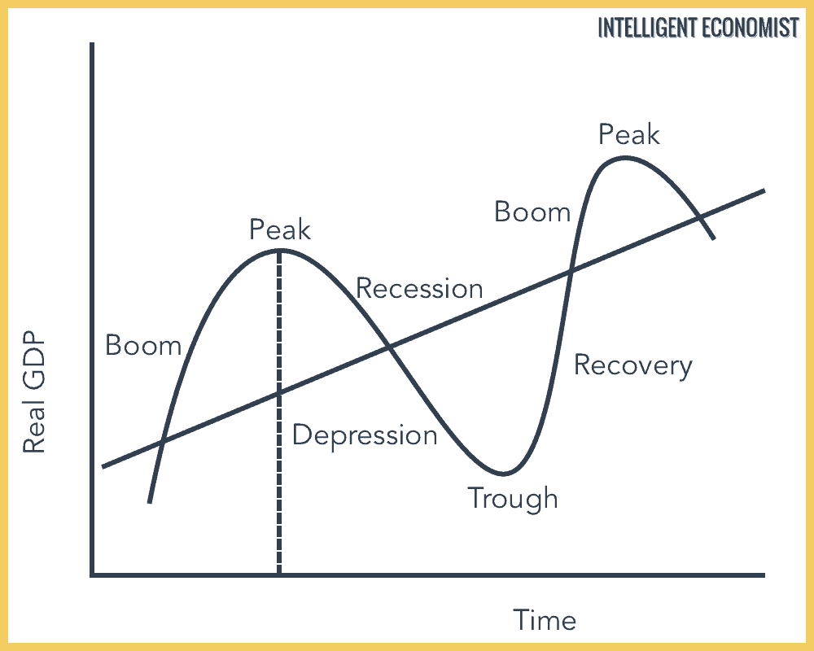
Business Cycle

Slide 20
Labor Force Growth during recessions
The size of labor which will either expand or contract during periods of recession and depression depends on the following two effects:
The Added Worker Effect
The Discourage Worker Effect
1. The Added Worker Effect: This effect leads to a temporary increase in the size of the labor force during recessions and depressions.
The Added Worker Effect, therefore, represents the temporary entrance into the labor force of ‘secondary’ workers (wife or teenage children) in response to the unemployment of the primary head of household.

Slide 21
Labor Force Growth during recessions
The Added Worker Effect:
The loss of the husband’s earnings results in a large decrease in income for the entire family, setting off a pure negative income effect for the other family members.
Assuming that leisure is a normal good, the reduction in family income will lead to a decreased demand for leisure and a greater supply of labor as the wife or teenaged children seek work to supplement the family income.
From wife’s point of view, as her non-labor income is reduced her reservation wage decline, and at some points she finds it advantageous to join the labor force.

Slide 22
Labor Force Growth during recessions
The Added Worker Effect:

Slide 23
Labor Force Growth during recessions
2.) The Discourage Worker Effect:
The positive impact on labor force growth of the added worker effect is offset by the simultaneous occurrence during recessions of the discourage worker effect.
Suppose, individual’s ongoing market wage is W1 per hour.
The budget constraint is AB and hours of work per week are H1.
Assume that a recession begins and the person is laid off from his or her job, however, each hour spent in the labor force does not pay W1, but some lesser amount.

Slide 24
Labor Force Growth during recessions
2.) The Discourage Worker Effect:
The lesser amount of wage is equal to E(W1), the expected value of wage. In equation, this expected value is equal to: E(W1)= pW1
Where p is the probability of finding another job paying W1.
If W1= $8 and there is a 50% chance of obtaining such a job (p= 0.5), the average return the unemployed worker can expect from this hour in the labor force is only 0.5x$8= $4.
For someone without a job, the opportunity cost of not working is only E(W1), not W1

Slide 25
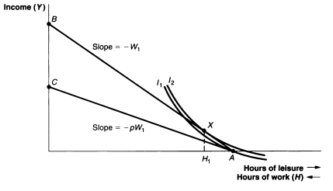
2.) The Discourage Worker Effect
If the probability of finding a job is sufficiently low, the expected value of wage will fall below the person’s reservation wage, and he or she will give up the job search altogether and drop out of the labor force.

